Slide 1



Health and Safety
ICT and the Law
This icon indicates the slide contains activities created in Flash. These activities are not editable.
For more detailed instructions, see the Getting Started presentation.

Slide 2
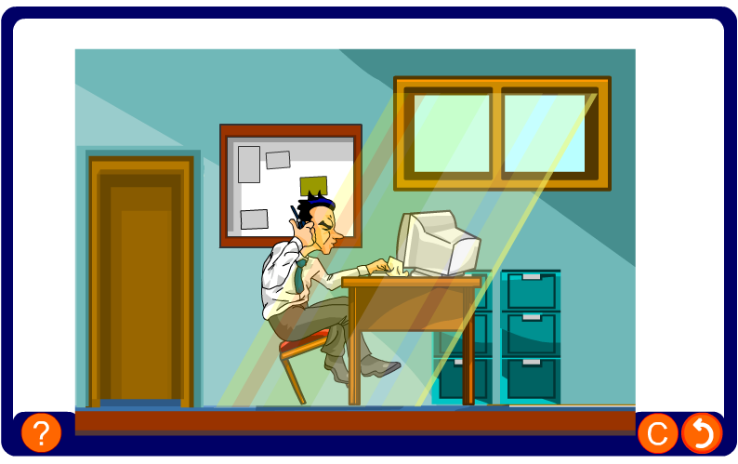
How many things will have a bad effect on this man’s health?
This is why we need health and safety regulations.

Slide 3
The purpose of the act
The Health and Safety at Work Act means that employers have a duty to look after the health and safety of their employees.
They have to assess the risk of the employee getting hurt or becoming ill and do all they can to avoid it happening.
People who use computers for most of the day are exposed to certain risks, and these are the people the regulations cover.

Slide 4
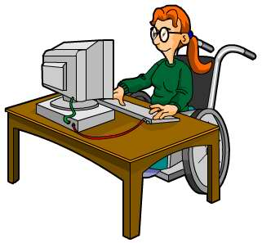

What does the employer have to do?
Employers need to look at:
the whole workstation including equipment, furniture, and the work environment
the job being done
any special needs of individual staff.
They have to assess the risks and do as much as they can to reduce them.

Slide 5
Employers obligations
Under the Health and Safety legislation Employers must:
Analyse workstations to assess and reduce risks
Ensure that workstations meet the minimum requirements
Plan for breaks and changes in work activities
Arrange and pay for eye tests and glasses if required
Provide health and safety training and information
The employer must then take appropriate action to meet these obligations.

Slide 6
What problems are there?
Most of the problems are caused by the fact that people are sitting in the same position doing the same task over and over again.
Sitting at the wrong height and in the same position for long periods of time is the most common cause of back pain.
Using the keyboard and fingers and repeatedly making the same small movement over and over again can cause carpal tunnel syndrome and other forms of RSI – repetitive strain injury.
Glare or reflections from windows or lights and a dirty screen are the most common cause of eyestrain and headaches.

Slide 7
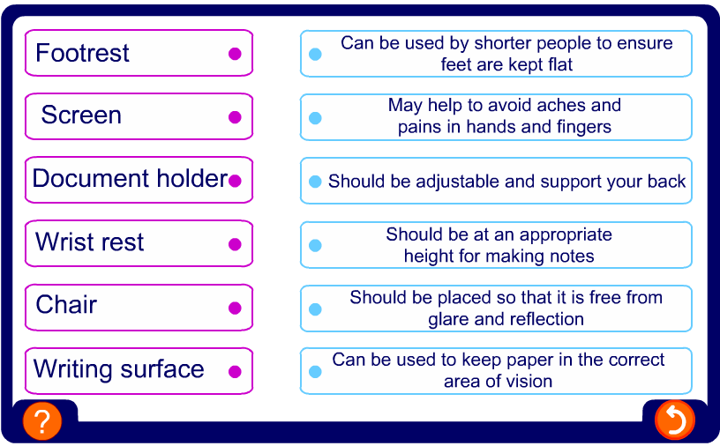
Design of workstations
Many of the problems can be avoided if workstations are designed properly so that the user can work comfortably.

Slide 8
Design of tasks
If possible, it is better for employees to have a change of task rather than sit in front of a screen all day. If that isn’t possible, they will need to take regular breaks.
The fact that computers provide a record of every working moment can put a lot of stress on employees who are expected to meet very demanding targets.
Employers can help by providing the right training and setting realistic targets.
They should also make sure that the employees have regular eyesight checks.

Slide 9
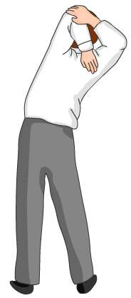
Training
Employees should be trained so that they understand:
how to adjust the furniture so that they are sitting properly
how to adjust the monitor setting depending on the lighting in the room
that it is important to change position regularly
that they must actually take their breaks – regular short breaks are better than one longer one
how to report any problems they may have.

Slide 10

Summary
Employers have a duty to look after the health and safety of their employees.
Employers need to assess the working environment, the type of job carried out and any special requirements of their employees.
Risks must be assessed and all efforts made to reduce them.
Most problems for ICT workers can be reduced by having the correct height work surface, an adjustable chair and the correct lighting.
Regular breaks and annual eye checks are also very important
Employees should have the appropriate training to minimize the risk of injury.

